Slide 1
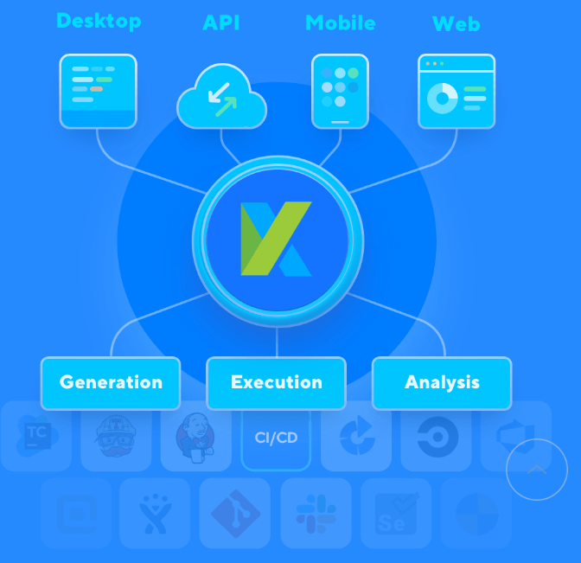
Overview

Slide 2
Features
Features | Katalon Studio | Selenium (eg. Devote)
Test development platform | Cross-platform | Cross-platform
Application under test | Web and mobile apps and API | Web apps, API (code)
Scripting languages | Java/Groovy | Java, C#, Perl, Python, JavaScript, Ruby, PHP
Programming skills | Not required. Recommended for advanced test scripts Both manual(Select from Drop Down) and scripting ide is provided | Advanced skills needed to integrate various tools
Learning curves | Medium | High
Ease of installation and use | Easy to setup and run | Require installing and integrating various tools
Script creation time | Quick | Slow
Object storage and maintenance | Built-in object repository, XPath, object re-identification | XPath, UI Maps
Image-based testing | Built-in support | Require installing additional libraries
DevOps/ALM integrations | Many | Additional integration has to be done
Continuous integrations | Popular CI tools (e.g. Jenkins, TeamCity) | Various CI tools (e.g. Gitlab with Launchpad)
Test Analytics | Katalon Analytics | No
Product support | Ticketing support, community, dedicated staff (third-party support services) | Open source community
License type | Licensed | Open source (Apache 2.0)
Best Suited | Best for API and UI
Frameworks | Sample framwork say hybrid, BDD available | Have to create from Start
Reports | Inbuilt report generation | Inbuild Report generate

Slide 3
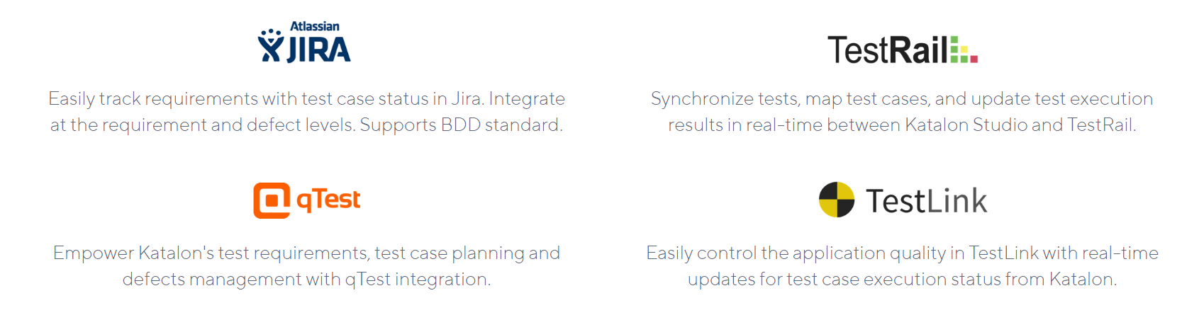
SDLC Test Management Integration

Slide 4
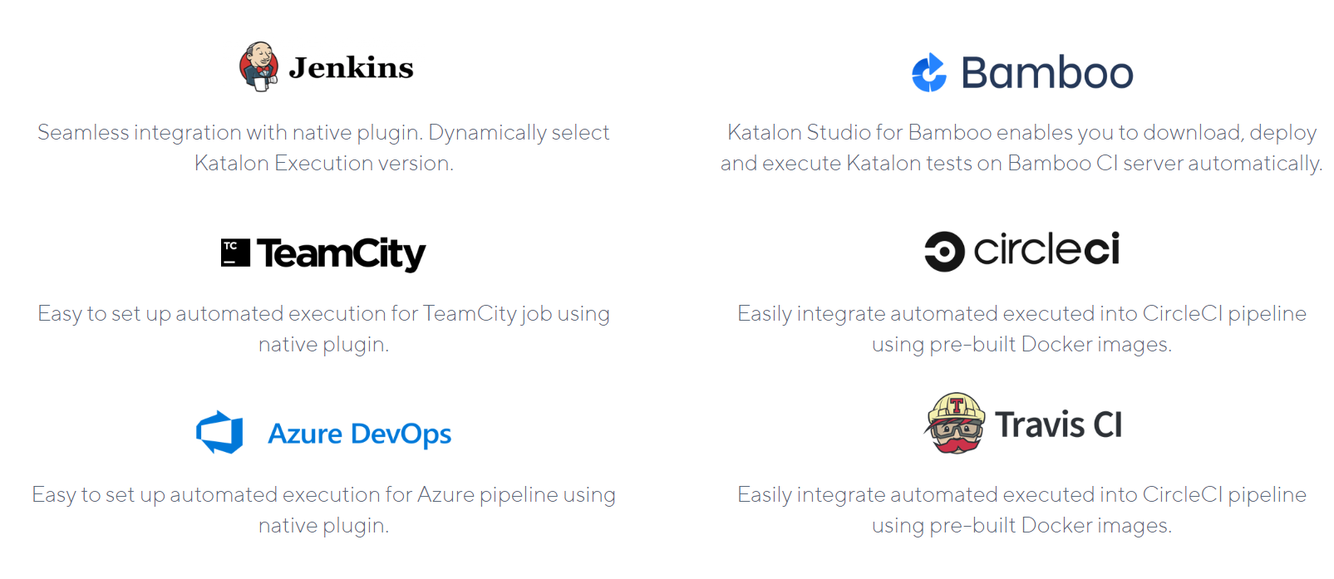
CI/CD

Slide 5
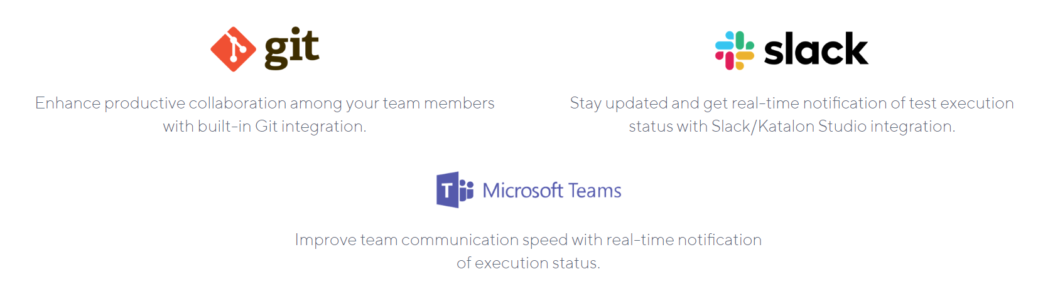
Collaboration

Slide 6
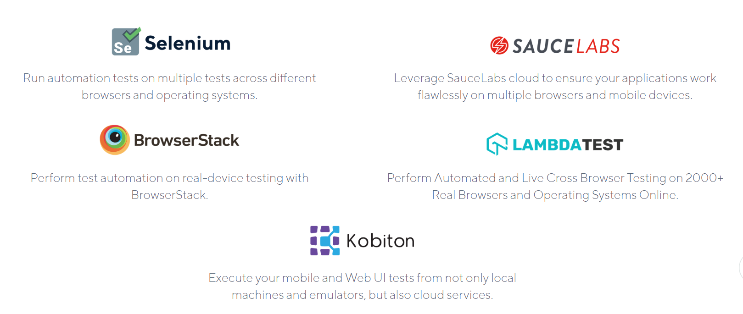
Execution Platform

Slide 7

Visual Testing

Slide 8
Features
Smart XPath for auto-healing
AI-powered XPath location mechanism. Generate full sets of XPath options to adapt to AUT changes.
Rich set of plugins
Enhance testing capabilities with Katalon Store plugins — contributed by community and enterprises.
Flexible execution engine
Run tests at any step on multiple browsers and devices — locally or with cloud services.
CI/CD readiness
Various native plugins to integrate with most popular CI tools: Jenkins, Bamboo, TeamCity, Azure DevOps, and more.
Insightful quality and performance reports
Diversified reports to control product quality and performance. Easily detect anomalies for improving.

Slide 9
Features
Smart XPath for auto-healing
AI-powered XPath location mechanism. Generate full sets of XPath options to adapt to AUT changes.
Rich set of plugins
Enhance testing capabilities with Katalon Store plugins — contributed by community and enterprises.
Flexible execution engine
Run tests at any step on multiple browsers and devices — locally or with cloud services.
CI/CD readiness
Various native plugins to integrate with most popular CI tools: Jenkins, Bamboo, TeamCity, Azure DevOps, and more.
Insightful quality and performance reports
Diversified reports to control product quality and performance. Easily detect anomalies for improving.

Slide 10
Features
Smart XPath for auto-healing
AI-powered XPath location mechanism. Generate full sets of XPath options to adapt to AUT changes.
Rich set of plugins
Enhance testing capabilities with Katalon Store plugins — contributed by community and enterprises.
Flexible execution engine
Run tests at any step on multiple browsers and devices — locally or with cloud services.
CI/CD readiness
Various native plugins to integrate with most popular CI tools: Jenkins, Bamboo, TeamCity, Azure DevOps, and more.
Insightful quality and performance reports
Diversified reports to control product quality and performance. Easily detect anomalies for improving.

